Slide 1

Unit-2
Agile Development
SOFTWARE ENGINEERING
2160701

Slide 2
Outlines
Agility and Agile Process Model
Extreme Programming
Other Process Model of Agile Development and Tools

Slide 3

What is Agility?
Effective response to change
Change
Request
Current Functionality
Change
Request
Current Functionality
© randomactsofleadership.com

Slide 4
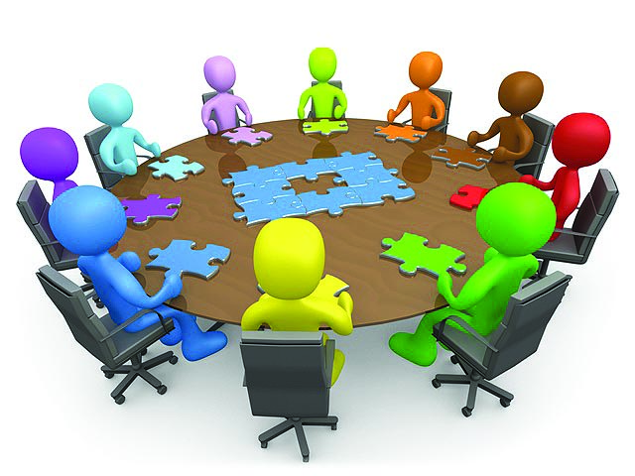
What is Agility? (Cont…)
Effective communication among all stakeholders
© www.clipartkid.com

Slide 5

What is Agility? (Cont…)
Drawing the customer onto the team
Eliminate the “us and them” attitude
Software Development Team
Customer
© marketculture.files.wordpress.com

Slide 6
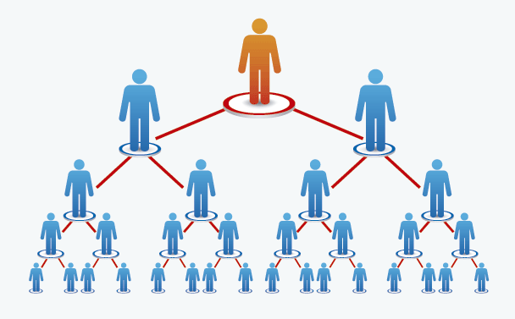
What is Agility? (Cont…)
Organizing a team so that it is in control to perform the work
Top Management
Project Manager
Team Lead
Senior Developer
Developer
© www.eudigital.co

Slide 7
Principles to achieve agility
Highest priority -> satisfy the customer
Welcome change requirements
Deliver working software frequently
Business people and developers must work together
Build projects around motivated individuals
Emphasize face-to-face conversation
Measure the Progress as per the Working Software
Maintain Constant Pace
Continuous attention to technical excellence and good design
Simplicity
The best designs emerge from self-organizing teams
The team tunes and adjusts its behaviour to become more effective

Slide 8
Agile Software Process
An agile process must be adaptable
It must adapt incrementally
Requires customer feedback
An effective catalyst (main source) for customer feedback is an operational prototype

Slide 9
Agile Process Models
Extreme Programming (XP)
Adaptive Software Development (ASD)
Dynamic Systems Development Method (DSDM)
Scrum
Feature Driven Development (FDD)
Crystal
Large Scale Scrum
Kanban

Slide 10
1. Extreme Programming (XP)
The most widely used agile process, originally proposed by Kent Beck.
XP uses an object-oriented approach as its preferred development paradigm (ideal pattern).
Defines four framework activities
  Planning
  Design
  Coding
  Testing

Slide 11
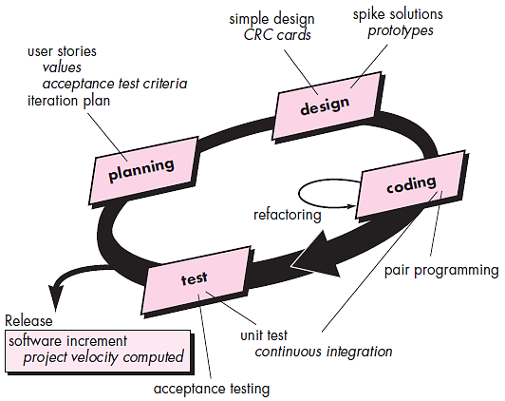
Extreme Programming (XP) (Cont…)
CRC: class-responsibility collaborator
© Roger S. Pressman

Slide 12
i. XP - Planning
User story-cards
  Instead of creating large requirement documents, user stories are written by the customer. In which what they need is mentioned.
Release planning
  Release plan for overall project is prepared
  From which the iteration plan can be prepared for individual module.
Small releases
  Plan for releasing the small functionalities
Iterative process
  Keep the iteration of nearly equal length
Stand up meetings
  The stand up meetings must be conducted for the current outcomes

Slide 13
ii. XP - Design
Simple design
  It is always good to keep the things simple to meet the current requirements
Spike solution
  For answering the tough technical problem
Refactoring
  Reduction in the redundancy, elimination of unused functionalities

Slide 14
iii. XP - Coding
Customer availability
  In XP, customer should be the part of the project development
Paired programming
  All code must be coded by groups of two people working at the same computer
Collective code ownership
  By having collective code ownership approach,
    Everyone contributes new ideas
    Anyone can change any line of code to fix a bug

Slide 15
iv. XP - Testing
Unit testing
  All the code must be tested by unit testing using test cases before its release
Continuous integration
  As soon as one task is finished, integrate it into the whole system
No overtime
  Conduct the release plan meeting to change the scope or to reschedule the project delivery

Slide 16
2. Adaptive Software Development (ASD)
Adaptive Software Development (ASD) was proposed by Jim Highsmith.
This is a technique for building complex software systems using iterative approach.
ASD focus on working in collaboration and team self-organization.
ASD incorporates three phases
  Speculation
  Collaboration
  Learning

Slide 17
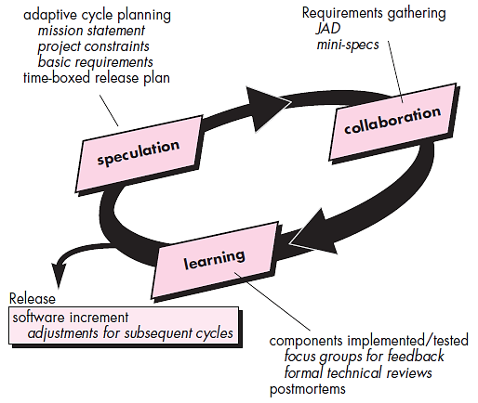
Adaptive Software Development (ASD)
JAD : Joint Application Development

Slide 18
Speculation
The adaptive cycle planning is conducted.
In this cycle planning mainly three types of information is used
  Customer’s mission statement
  Project constraints
    Delivery date, budgets etc…
  Basic requirements of the project

Slide 19
Collaboration
In this, collaboration among the members of development team is a key factor.
For successful collaboration and coordination it is necessary to have following qualities in every individual
  Assist each other without offense
  Work hard
  Posses the required skill set
  Communicate problems and help each other
  Criticize without any hate

Slide 20
Learning
Emphasize is on learning new skills and techniques.
There are three ways by which the team members learn
  Focus groups
    The feedback from the end-users is obtained.
  Formal technical review
    This review is conducted for better quality.
  Postmortems
    Team analyses its own performance and makes appropriate improvements.

Slide 21
DSDM
The Dynamic Systems Development Method (DSDM) is an agile framework that addresses the entire project lifecycle and its impact on the business.
Like the broader agile philosophy, DSDM is an iterative approach to software development, and this framework explicitly states “any project must be aligned to clearly defined strategic goals and focus upon early deliver of real benefits to the business.

Slide 22
3. Dynamic Systems Development Methods (DSDM)
Various phases of this life cycle model
  Feasibility study
    the viability of the application is determined
  Business study
    The functional and informational requirements are identified and then the business value of the application is determined
  Functional model iteration
    The incremental approach is adopted for development
  Design and build iteration
    If possible, design and build activities can be carried out in parallel
  Implementation
    The software increment is placed in the working environment
The DSDM can be combined with XP method or ASD concepts to create combinational model.

Slide 23
3. Dynamic Systems Development Methods (DSDM)
DSDM’s strengths include:
Basic product functionality can be delivered rapidly
Developers have easy access to end-users
Projects are reliably completed on time
DSDM’s weaknesses include:
Can represent a dramatic and disruptive change in company culture
Costly to implement
Not ideal for small organizations

Slide 24
4. Scrum
This model is developed by Jeff Sutherland and Ken Schwaber in 1995.
Scrum is an agile process model which is used for developing the complex software systems.
It is a lightweight process framework.
Lightweight means the overhead of the process is kept as small as possible in order to maximize the productivity.

Slide 25
Scrum Principles
There are small working teams on the projects due to which there is maximum communication and minimum overhead.
The task of people must be partitioned into small and clean packets.
The process must accommodate the technical or business changes if they occur.
The process should produce software increments.
During product building the constant testing and documentation must be conducted.
The SCRUM process must produce the working model of the product whenever required.

Slide 26
Scrum Development Activities
Backlog
  It is a list of project requirements or features that must be provided to the customer.
  The items can be included in the backlog at any time.
  The product manager analyses this list and updates the priorities as per the requirements.
Sprint
  These are the work units that are needed to achieve the requirements mentioned in the backlogs.
  Typically the sprints have fixed duration or time box (of 2 to 4 weeks).
  Thus sprints allow the team members to work in stable and short-term environment.

Slide 27
Scrum Development Activities
Meetings
  There are 15 minutes daily meetings to report the completed activities, obstacles and plan for next activities.
  Following are three questions that are mainly discussed during the meetings.
    What are the tasks done since last meeting ?
    What are the issues that team is facing ?
    What are the next activities that are planned ?
Demo
  During this phase implemented functionalities are demonstrated to the customer.

Slide 28
Roles (Scrum)
Scrum master
  The scrum master leads the meeting and analyses the response of each team member.
  The potential problems are discussed and solved in meeting with the help of scrum master.
Team members
  These are the persons working in a team to develop the software solutions.
  Product Owner
  Scrum Product Owner is responsible for maximizing the value of the product resulting from the work of the Development Team.

Slide 29
Roles (Scrum)
Product Owner
  Scrum Product Owner is responsible for maximizing the value of the product resulting from the work of the Development Team.
  The Product Owner is the sole person responsible for managing the Product Backlog.

Slide 30
Roles (Scrum)
Product Owner
Clearly expressing Product Backlog items.
Ordering the items in the Product Backlog to best achieve goals and missions.
Optimizing the value of the work the Development Team performs.
Ensuring that the Product Backlog is visible, transparent, and clear to all, and shows what the Scrum Team will work on next.
Ensuring the Development Team understands items in the Product Backlog to the level needed.

Slide 31
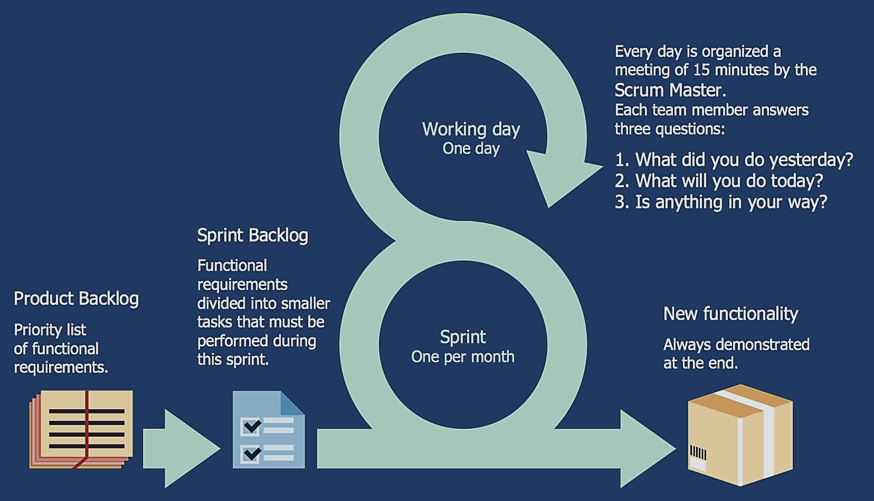
4. Scrum
© http://www.conceptdraw.com/examples/scrum-guide

Slide 32
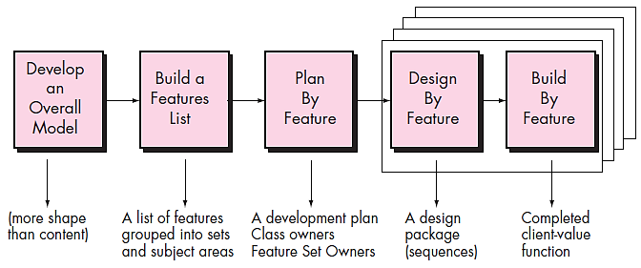
5. Feature Driven Development (FDD)
© Roger S. Pressman

Slide 33
Feature Driven Development (FDD)
Originally Peter Coad suggested this approach for object oriented software engineering.
Stephen Palmer and John Flesing has extended and enhanced Coad’s work.
In FDD, the feature means client valued function.
Various phases in the FDD life cycle
  Develop overall model
    The high-level walkthrough of scope and detailed domain walkthrough are conducted to create overall models.
  Build feature list
    List of features is created and expressed in the following form
      <action> the <result> <by for of to> a(n) <object>
      For Ex. “Display product-specifications of the product”

Slide 34
Feature Driven Development (FDD)
  Plan by feature
    After completing the feature list the development plan is created
  Design by feature
    For each feature the sequence diagram is created
  Build by feature
    Finally the class owner develop the actual code for their classes

Slide 35
Crystal
Crystal is an agile framework focusing on individuals and their interactions, as opposed to processes and tools. In other words, this framework is a direct outgrowth of one of the core values articulated in the Agile Manifesto.
The Crystal agile framework is built on two core beliefs:
Teams can find ways on their own to improve and optimize their workflows
Every project is unique and always changing, which is why that project’s team is best suited to determine how it will tackle the work

Slide 36
6. Crystal
Alistair and Highsmith suggested the crystal family of agile methods.
This method also contains roles, process patterns, work products and practice that are unique to each.
Thus the crystal family is actually a set of agile processes that are useful for different types of projects.
The agile team has to select the members of the crystal family that is most appropriate for their on going project and environment.

Slide 37
6. Crystal
Which approach will be most suitable for your projects depends on three dimensions:
Team size
Criticality
What the priority of the project is
Generally, they are characterized by colors, according to the number of people involved in the project:
Clear - for teams of 8 or fewer people
Yellow - for teams of 10-20 people
Orange - for teams of 20-50 people
Red - for teams of 50-100 people

Slide 38
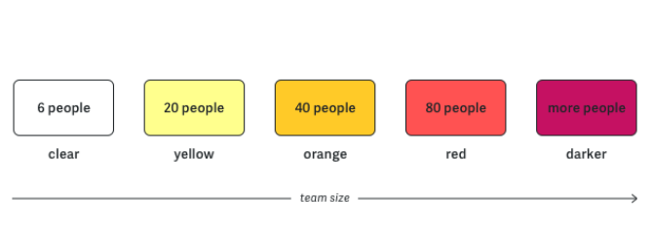
6. Crystal

Slide 39
5. Large Scale Scrum(LeSS)
The LeSS Framework is a way to scale the work of multiple teams doing scrum.
LeSS shows how to handle Large and complex development.
LeSS applies to products with 2-8 teams.

Slide 40
LeSS Principles:-
Transparency
More with less
Whole-Product focus
Customer centric
Lean thinking
Continuous improvements towards perfection
System thinking
Empirical process control
Queuing theory

Slide 41
LeSS Framework
The LeSS framework is for one product owner who owns the product and who manages one product backlog worked.
Roles:- One product owner, Area Product owner, 2-8 teams, Scrum master for 1-3 teams.
Artifacts:- One potentially shippable product increment, one product backlog and a separate sprint backlog for each team.
Events:- One common sprint for the whole product, it includes all teams and ends in one potentially shippable product increment.
Rules and guide:- Rules for barely sufficient scaling framework for empirical process control and whole product focus. Guides may help.

Slide 42
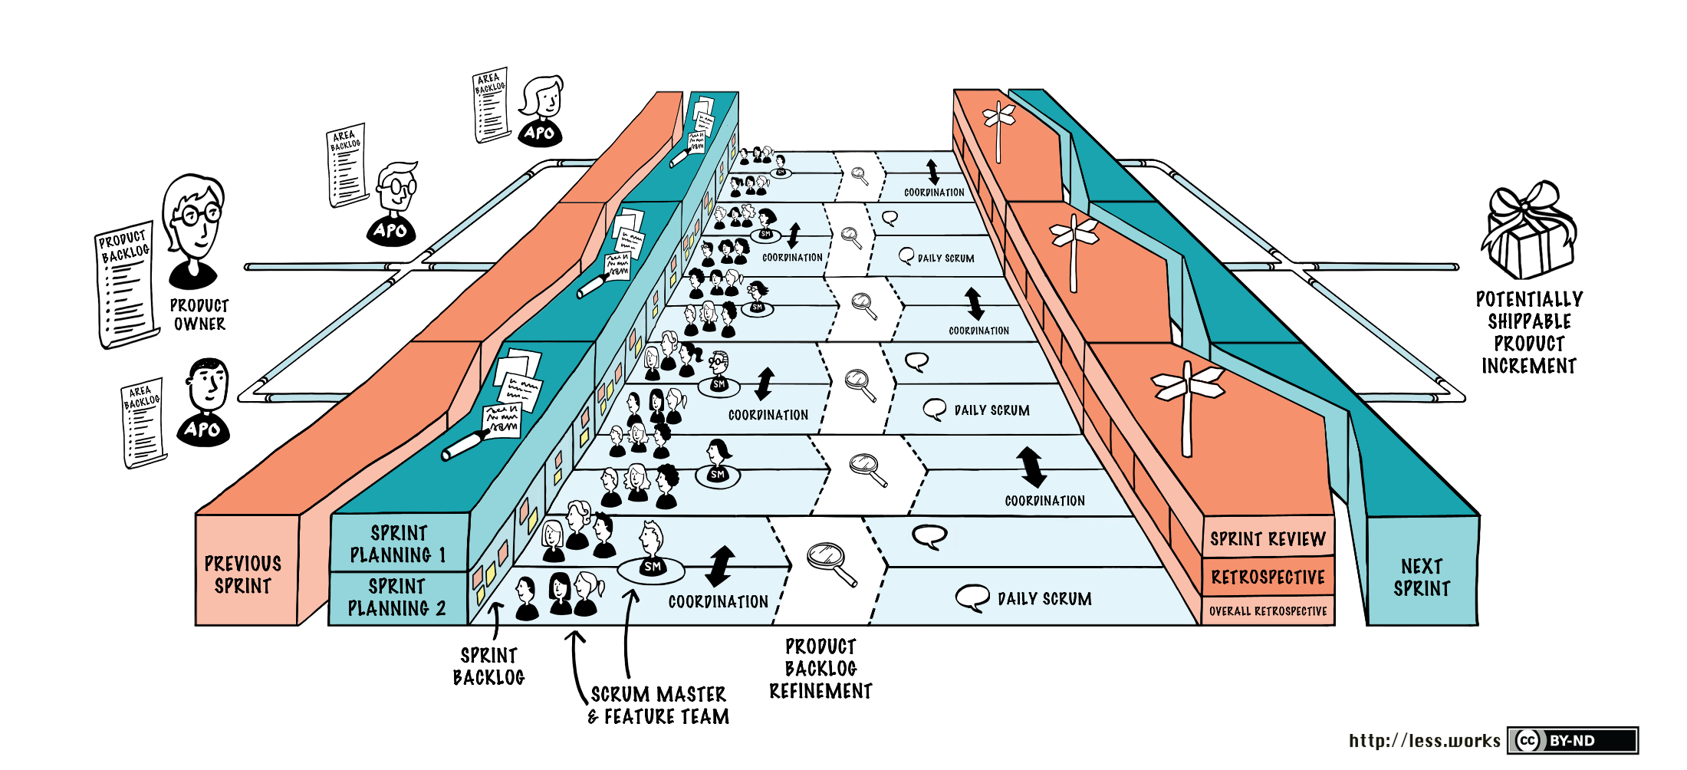

Slide 43
Kanban
Kanban is a popular framework used to implement agile and DevOps software development.
It requires real-time communication of capacity and full transparency of work.
Work items are represented visually on a kanban board, allowing team members to see the state of every piece of work at any time.

Slide 44
History
Kanban is enormously prominent among today's agile and DevOps software teams, but the kanban methodology of work dates back more than 50 years.
In the late 1940s Toyota began optimizing its engineering processes based on the same model that supermarkets were using to stock their shelves.
Supermarkets stock just enough product to meet consumer demand, a practice that optimizes the flow between the supermarket and the consumer.
Because inventory levels match consumption patterns, the supermarket gains significant efficiency in inventory management by decreasing the amount of excess stock it must hold at any given time.
Meanwhile, the supermarket can still ensure that the given product a consumer needs is always in stock.

Slide 45
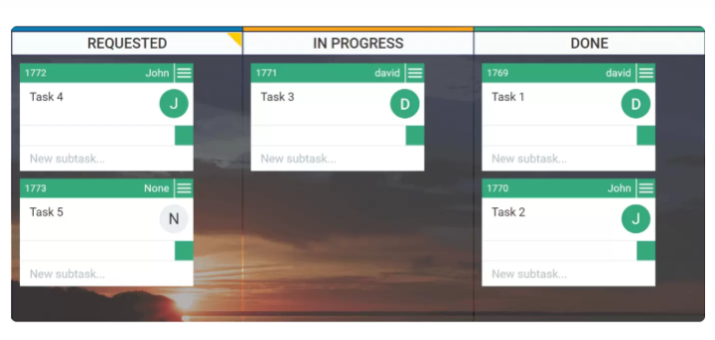
Kanban
Agile software development teams today are able to leverage these same JIT principles by matching the amount of work in progress (WIP) to the team's capacity. This gives teams more flexible planning options, faster output, clearer focus, and transparency throughout the development cycle.
Kanban Board

Slide 46
Kanban Board
The work of all kanban teams revolves around a kanban board, a tool used to visualize work and optimize the flow of the work among the team.
While physical boards are popular among some teams, virtual boards are a crucial feature in any agile software development tool for their traceability, easier collaboration, and accessibility from multiple locations.
The kanban methodology relies upon full transparency of work and real-time communication of capacity, therefore the kanban board should be seen as the single source of truth for the team's work.

Slide 47
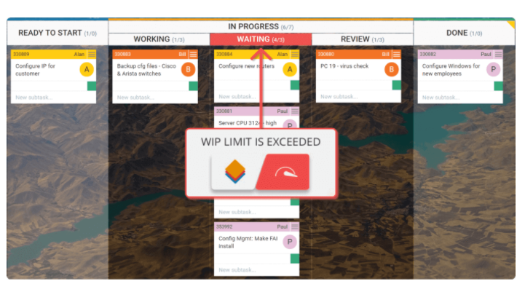
Kanban
Limit Work in Progress

